Slide 1
Introduction to JMeter and Taurus
Rachna Bafna

Slide 2
Overview
Why Performance Engineering?
Holiday Readiness and Holiday Outages
Load Testing and Performance Engineering
JMeter and Taurus
Demo
Questions

Slide 3
Why Performance Engineering?
To ensure that your application/product is:
Scalable - The ability of a computer application or product to continue to function well when it is changed in size or volume in order to meet a user need.
Reliable - The ability of a system or component to function under stated conditions for a specified period of time.
Meets Service Level Agreements(SLAs) for - Response Time, Throughput and Utilization.

Slide 4
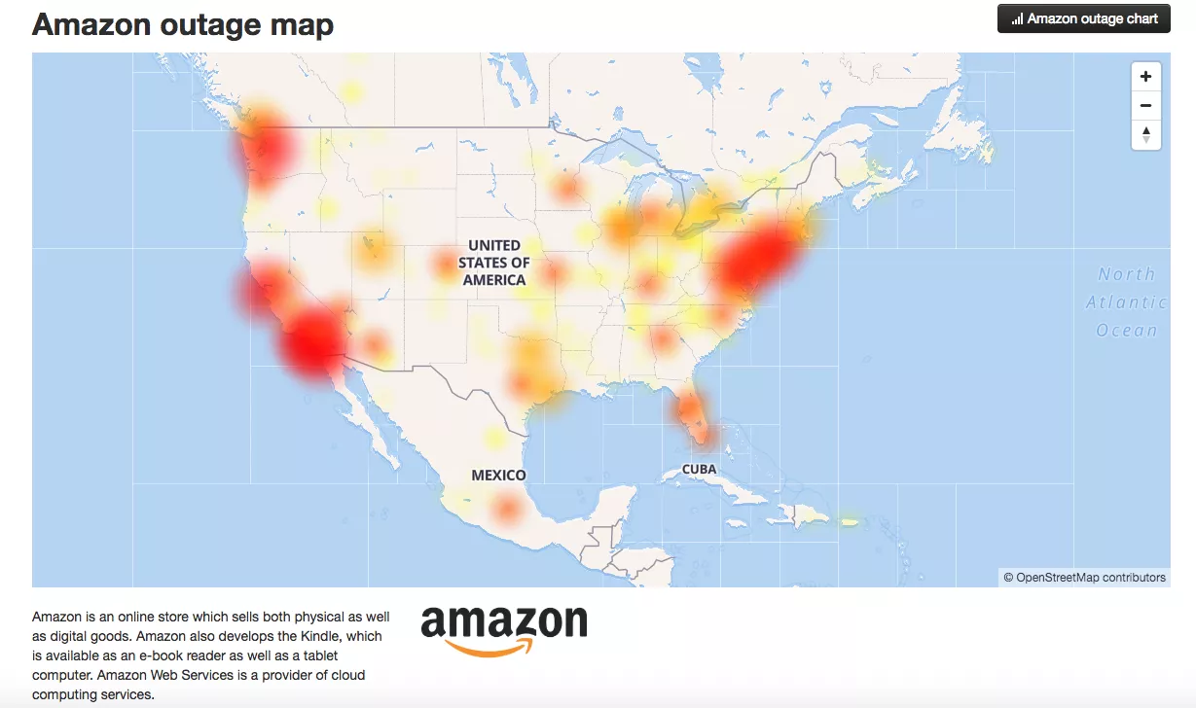
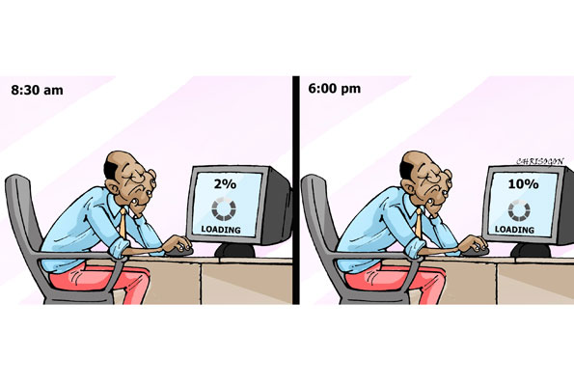
Holiday Readiness and Outages
Accomplishment 2
Ut enim ad minim veniam, quis nostrud exercitation ullamco laboris nisi ut aliquip ex ea commodo consequat.

Slide 5
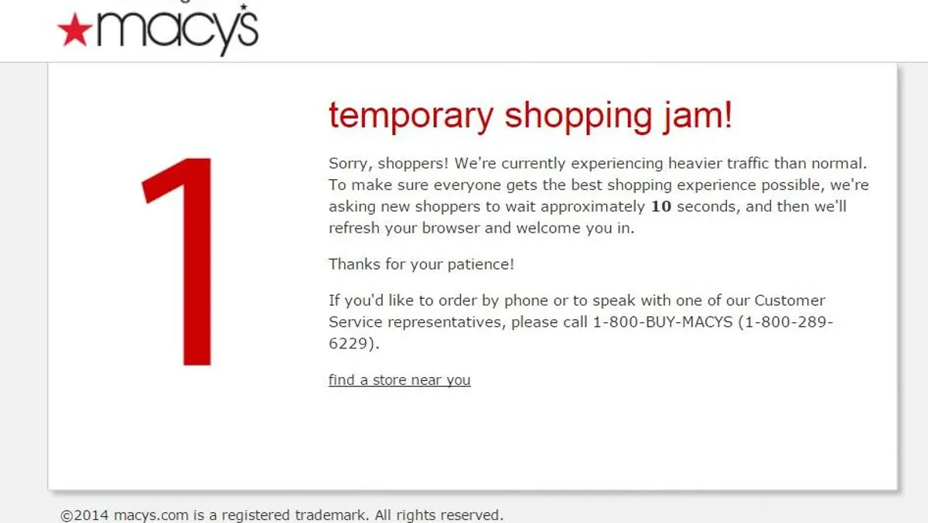
Holiday Readiness and Outages

Slide 6
What is Performance Engineering?
Techniques applied during a systems development life cycle to ensure the non-functional requirements for performance like
Throughput,
Latency, or
Resource Utilization

Slide 7
Some Facts Around Response Times
47% of consumers expect a web page to load in 2 seconds or less.
40% of people abandon a website that takes more than 3 seconds to load.
A 1 second delay in page response can result in a 7% reduction in conversions.
If an e-commerce site is making $100,000 per day, a 1 second page delay could potentially cost you $2.5 million in lost sales every year.

Slide 8
Load Testing and Performance Engineering
Understand the traffic patterns.
Design the workload.
Write load test scripts.
Run the load tests.
Monitor and Analyze.
Optimize.
Repeat 3 through 6!
To complete this cycle, knowledge of at least one load testing tool is necessary.

Slide 9
Load Testing/Performance Testing Tools
Tools that can simulate a heavy load on a server, group of servers, network or object to test its strength or to analyze overall performance under different load types.
Popular Load Testing Tools
JMeter
Blazemeter
NeoLoad
LoadRunner
Gatling
WebLoad

Slide 10
JMeter and Taurus
Load Testing tool that supports dynamic and static web testing.
Ability to load and performance test many different protocol types:
Web - HTTP, HTTPS
SOAP / REST Webservices
FTP
Database via JDBC
LDAP
Mail - SMTP(S), POP3(S) and IMAP(S)
Taurus
Automation friendly framework to run JMeter tests more efficiently.
Supports tools like:
JMeter
Gatling
Locust
Selenium
And many more.

Slide 11
Demo

Slide 12
Session Details
5 Weeks Series
Starting from July 22nd every wednesday and Thursday
Time: 8am - 9am PST

Slide 13
Questions?

